Slide 1
How Can You Do CI/CD with SQL Databases using AKS and ACR and AzDO?

Slide 2

Rob Sewell – MVP – Consultant
SQLDBAWithABeard.com @sqldbawithbeard
Photo by Vladislav Klapin on Unsplash
Notes:
Introduction of Him and I

Slide 3
Continuous Delivery

Slide 4
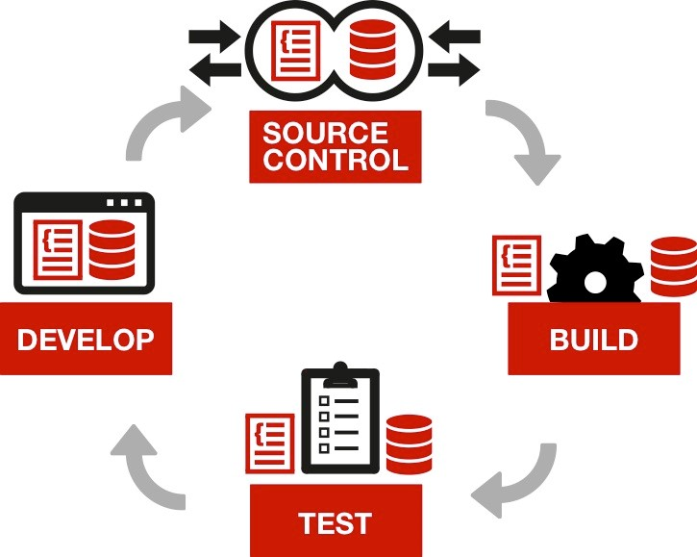
Continuous Integration

Slide 5
Azure Container Registry -ACR
Private Container registry
https://azure.microsoft.com/en-gb/services/container-registry/

Slide 6
Azure Container Registry -ACR
Create one using Azure CLI
az acr create --resource-group beardkubes --name beardacr --location westeurope --sku Basic
--admin-enabled

Slide 7
Build a Docker Image
Get the latest SQL Server Image
docker pull microsoft/mssql-server-linux:latest
Create Container and mount volume to host
docker run -d -p 15788:1433 --name 2017 -v C:\MSSQL\BACKUP:/var/opt/mssql/data/backup -e SA_PASSWORD=StupidPassw0rd -e ACCEPT_EULA=Y microsoft/mssql-server-linux

Slide 8
Prepare the image
Restore the database onto the image
$restoreDbaDatabaseSplat = @{
SqlCredential = $cred
Path = '/var/opt/mssql/data/backup/BACKUPFILE.bak'
SqlInstance = 'localhost,15788'
useDestinationDefaultDirectories = $true
}
Restore-DbaDatabase @restoreDbaDatabaseSplat
dbatools.io

Slide 9
Push to the ACR
Stop the container
Docker stop 2017
Create the image
Docker commit 2017 bearddevimage

Slide 10
Push to the ACR
Login to ACR
az acr login --name beardacr
List the server name
az acr list --resource-group beardkubes --query "[].{acrLoginServer:loginServer}" --output table

Slide 11
Push to the ACR
Tag the image
Docker tag bearddevimage beardacr.azurecr.io/bearddevimage:latest
Push the image to ACR
docker push beardacr.azurecr.io/bearddevimage:latest

Slide 12
Now we are ready
We have our Production database in a container which we can spin up in very small amount of time.
Our developers can use this for doing their development
I HAVENT MENTIONED PRODUCTION DATA

Slide 13
Kubernetes
The name Kubernetes originates from Greek, meaning helmsman or pilot, and is the root of governor and cybernetic. K8s is an abbreviation derived by replacing the 8 letters “ubernete” with “8”.
https://kubernetes.io/docs/concepts/overview/what-is-kubernetes/

Slide 14
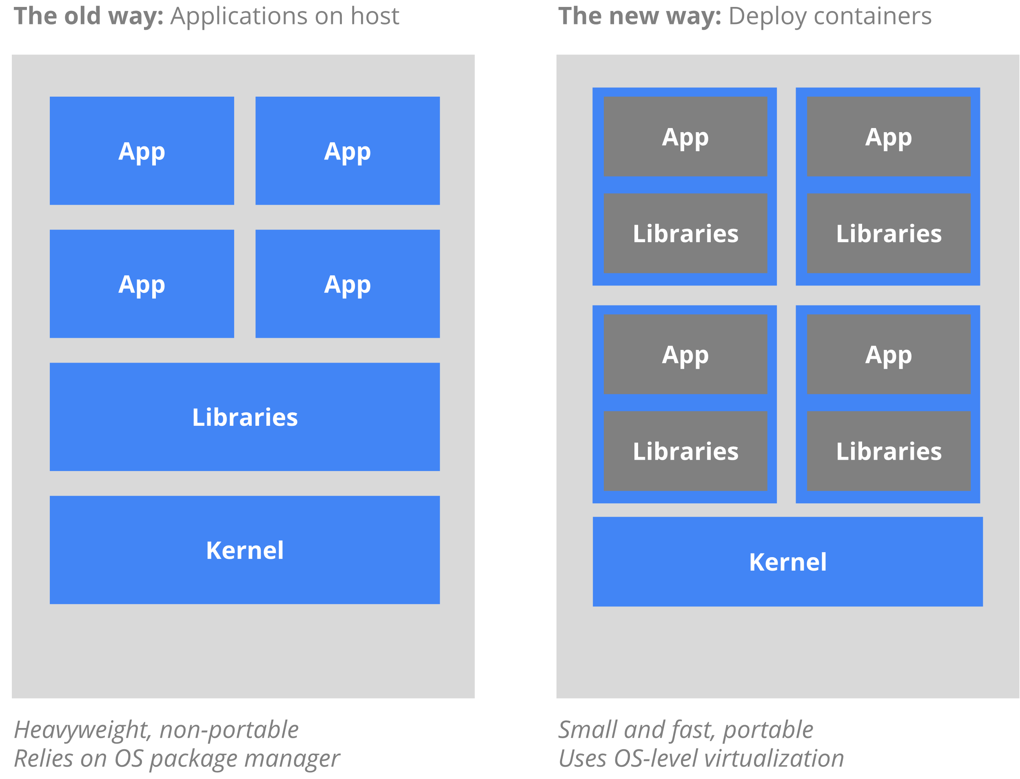
Kubernetes
https://kubernetes.io/docs/concepts/overview/what-is-kubernetes/

Slide 15
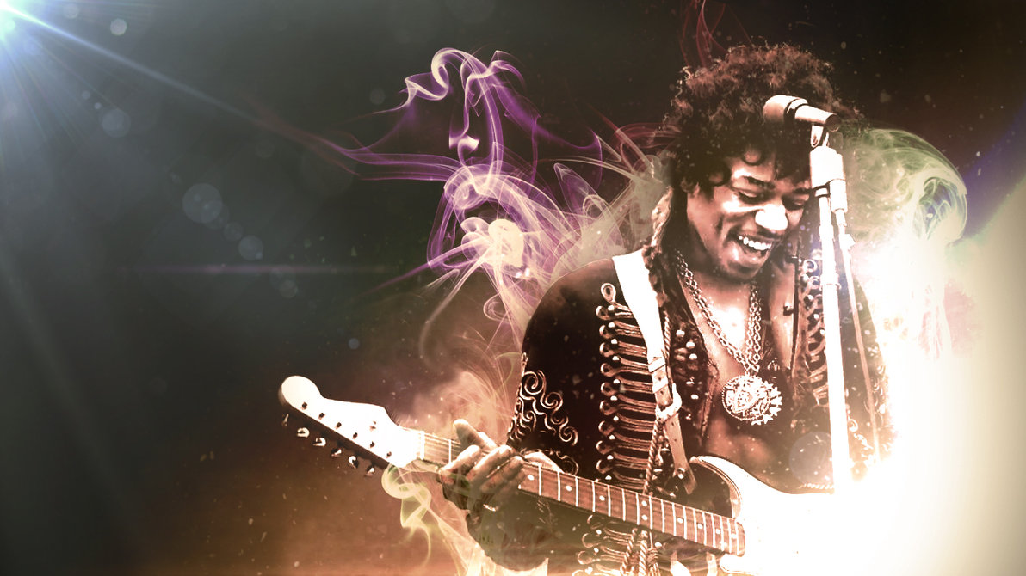
Just like Jimi Hendrix …
We love to get feedback
Please complete the
session feedback forms

